Slide 1
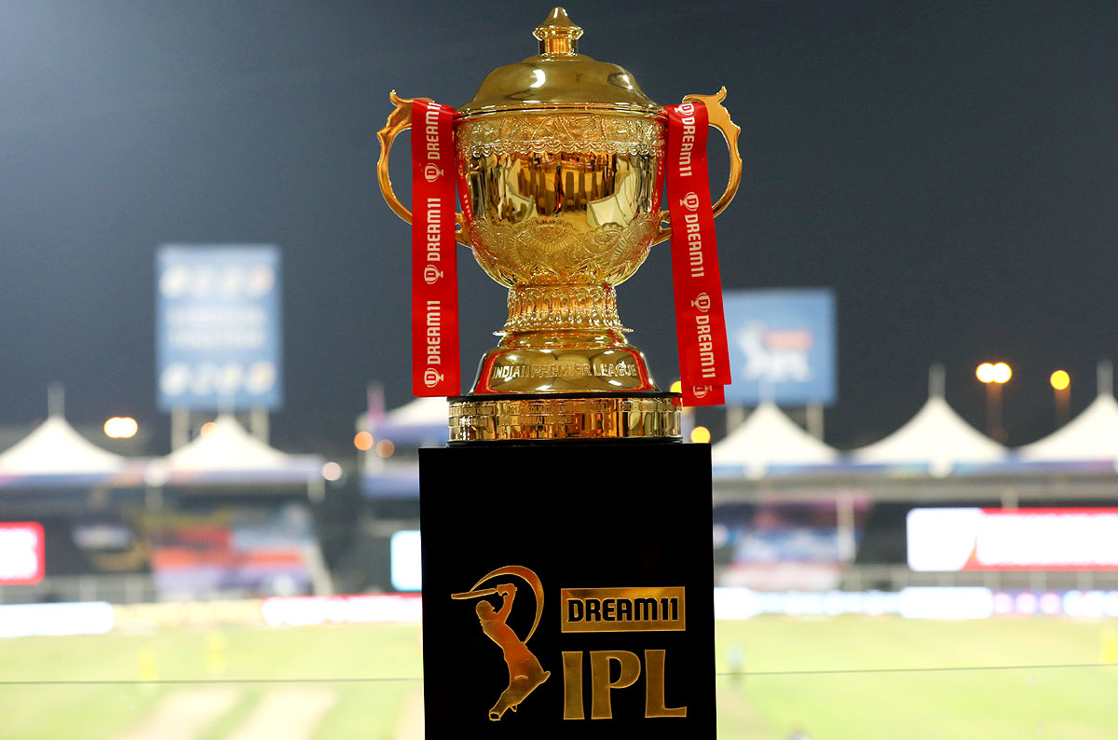
Indian Premier League (IPL)
Data Visualizations
(12/6/2021)
Presented by -
Umesh Kumar Gattem
Muhammad Murtaza Mir
Raunav Sharma

Slide 2
Introduction
IPL is one of the most vivid and entertaining sports leagues in the world.
IPL was founded by the Board of Control for Cricket in India(BCCI) in 2007 and has been played since 2008.
IPL is one of the reasons why India is producing a lot of talented young players across the country.

Slide 3
Problem Statement
As part of this project we are trying to visualize the different statistics like
Team statistics
Player statistics
Venue statistics
Season statistics
All these statistics being visualized are from seasons 2008-2020.

Slide 4
About the Dataset
The dataset that we will be analyzing is the IPL dataset.
The dataset contains five csv files, containing information about all the matches played and the Ball-by-Ball data of all the matches in all leagues played and season summary details and points table for all team across all seasons.

Slide 5
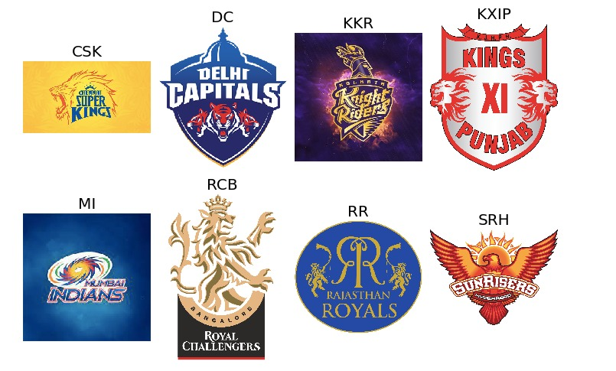
Team Logos and Names

Slide 6

Few Outliers in Data
There are 4 other teams which are not the common participants but played one or two seasons.

Slide 7
Team Colors That We’ve Used in Our Visualization
Mumbai Indians (MI) – BLUE
Chennai Super Kings (CSK) – YELLOW
Delhi Capitals (DC) - INDIGO
Punjab Kings (PK) – TOMATO
Kolkata Knight Riders (KKR) – BLACK
Rajasthan Royals (RR) - PINK
Royal Challengers Bangalore (RCB) – RED
Sunrisers Hyderabad (SRH) – ORANGE

Slide 8
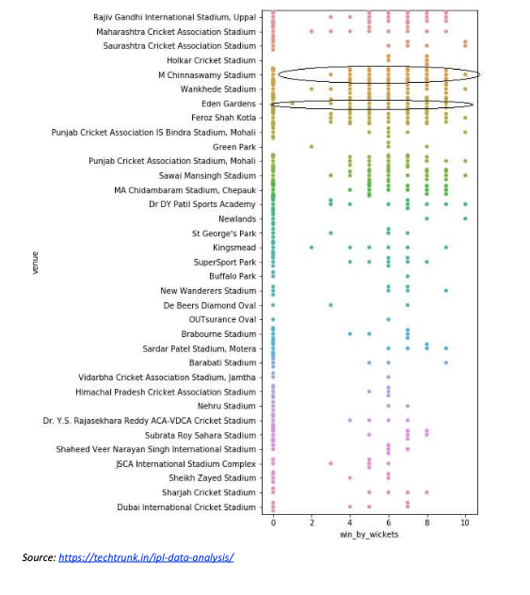
Existing Visualisations
The plot wants to convey the wins of the teams while chasing the score put up by the other team on the scorecard at different venues
But we know that while chasing, the least number of wickets with which a team can win is one and not zero
But the plot shows that there have been teams winning by zero wickets. Therefore, the plot has not been used appropriately.

Slide 9
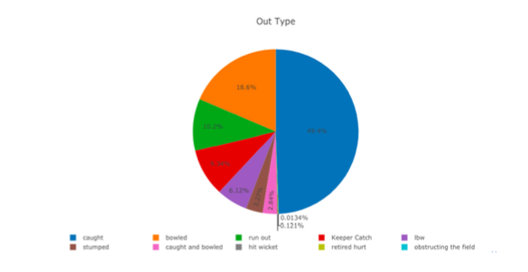
Existing Visualizations
There are few issues with this plot.
First thing is that it is a pie chart.
We know that Pie charts are one of the most overused graphs and in most cases are not the best way to present data especially when we are trying to categorize more variables.
They often distort the information and make it more difficult for decision-makers to understand the messages they contain.

Slide 10
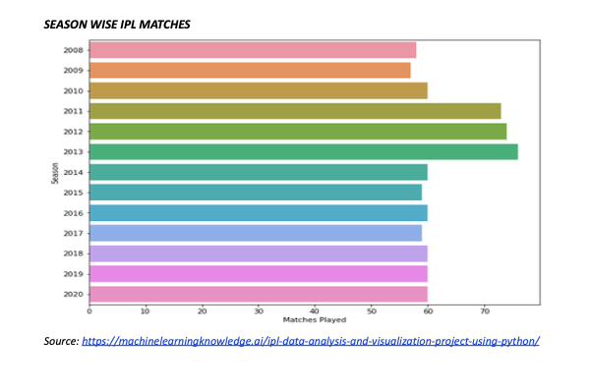
Existing Visualizations
The purpose of the visualization is to convey the number of matches played in each season.
Bar plot has been used to convey this information. In the context of this visualization, the plotting technique is appropriate.
The number of matches played in each season are represented by using length.
Length is very effective in terms of conveying quantities especially for representing the differences in the quantities.

Slide 11
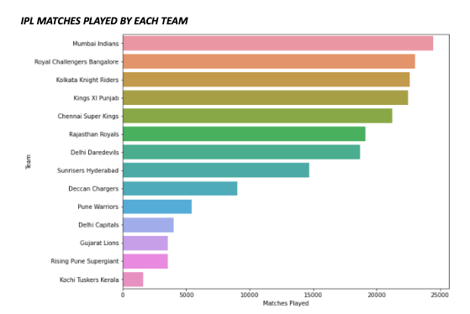
Existing Visualization
This plot intends to convey the total number of matches played by all the teams across all seasons.
However, the information conveyed is not correct. The X-Label is supposed to represent the total matches played.
In this plot, Mumbai Indians have played the most number of matches (which is factual) but are nowhere near the value of 25000.

Slide 12
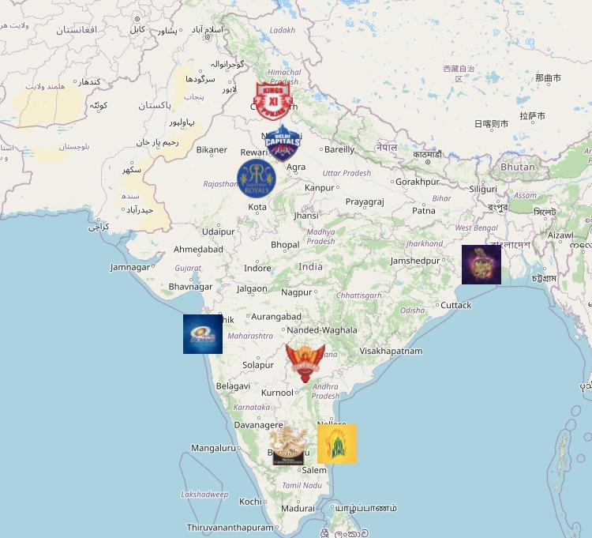
Home Grounds of Each Team
Teams will play more matches on their home grounds.
Sometimes we can say that the home team has an advantage on their home ground since they play more matches and therefore understand the pitch well.

Slide 13
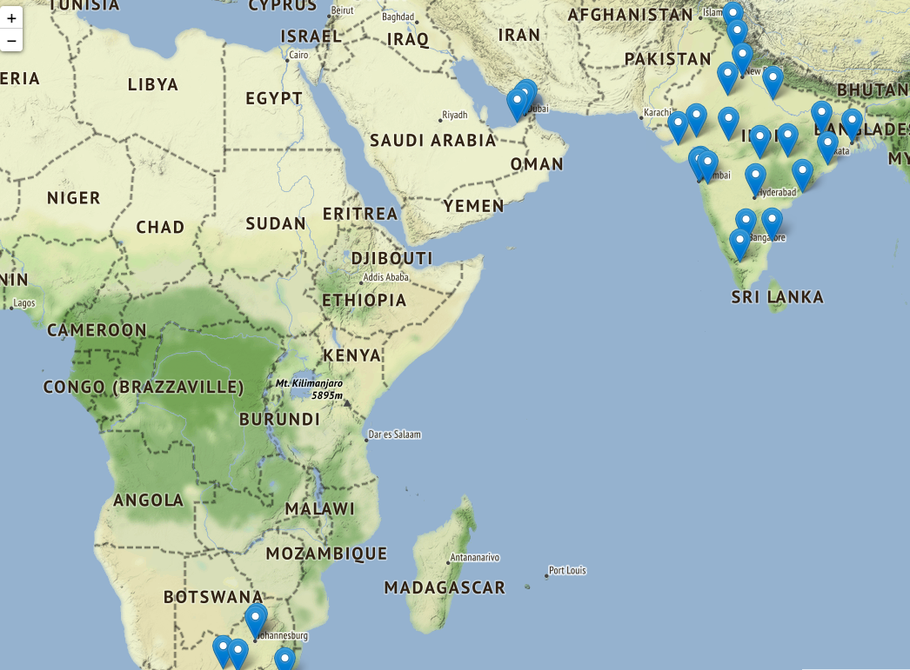
All the Venues of Stadiums
In the 2009 season, IPL has been played in South Africa due to some election reasons in India.
UAE has also hosted the IPL in 2020 due to some difficult times in India.
However, most of the times, the IPL will be played in India itself.

Slide 14
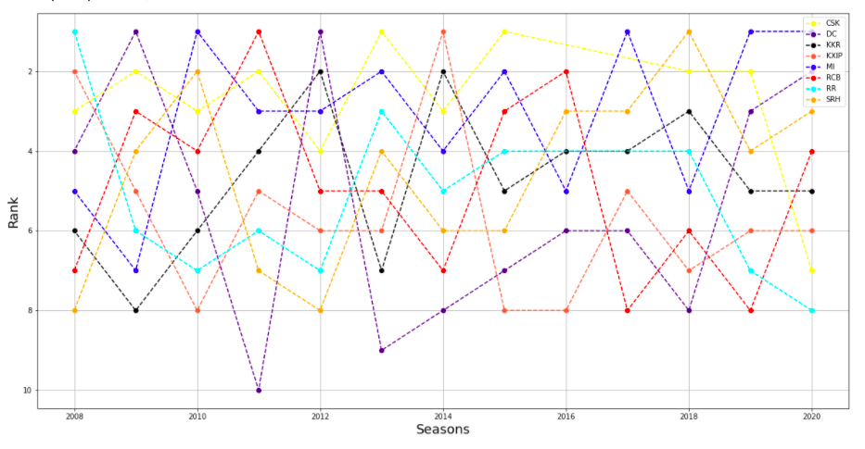
Team Position Across Seasons Using a Bump Chart
Benefits:
All the ranks can be visualized using one chart
Drawbacks:
We might miss the visualizations due to some intersections of lines.
Lines are zig-zag and difficult to understand.
Light colors.

Slide 15
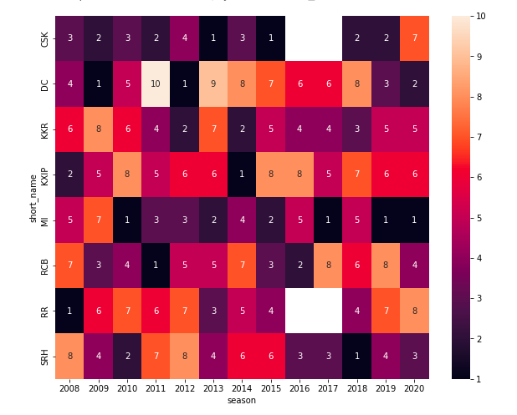
Team Position Across Seasons Using Heat Map
Benefits:
All the ranks can be visualized using one chart
Visualize the colors easily
No intersections

Slide 16

Let’s Visualize the Teams With More Wins Using World Cloud
Benefits:
Easy to visualise the text size since we have less of the variables.
Since we have less attributes in this scenario (max 12 teams), this plot is easy to visualize.

Slide 17
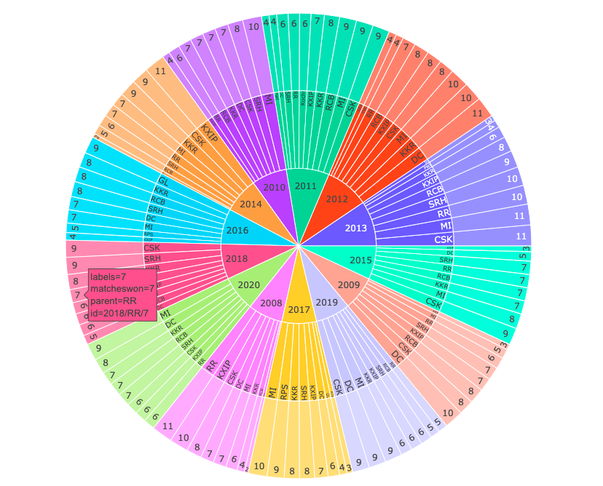
Number of Wins by Each Team in Each Season Using a Sunburst Chart
Drawbacks
Too much information in one chart
Hard to go through each variable
Benefits:
Label will help us understand the data when we hover over that.

Slide 18
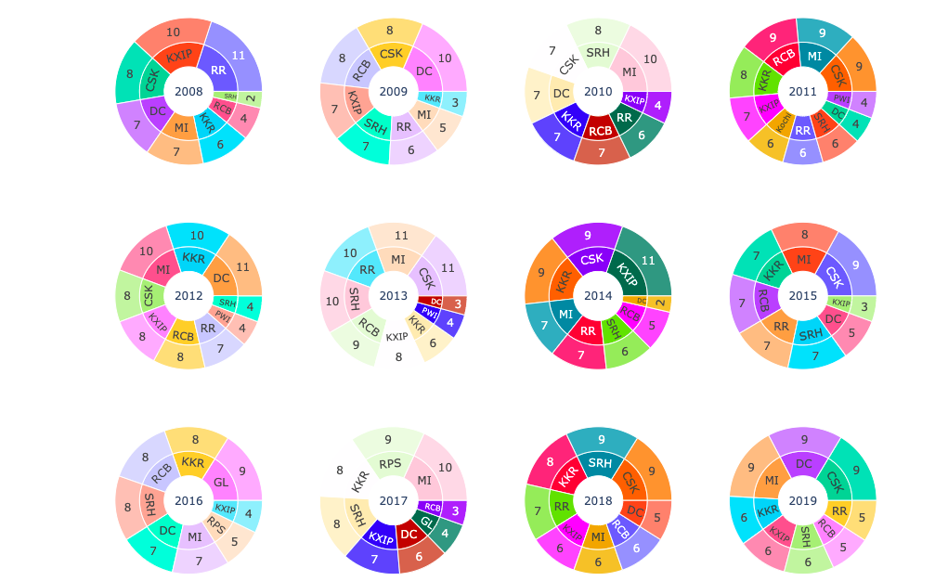
Better Solution
Drawbacks:
Color is not constant.
Positions are not constant across the plots so it is difficult to visualize each.
No information of number of matches lost by each team.

Slide 19
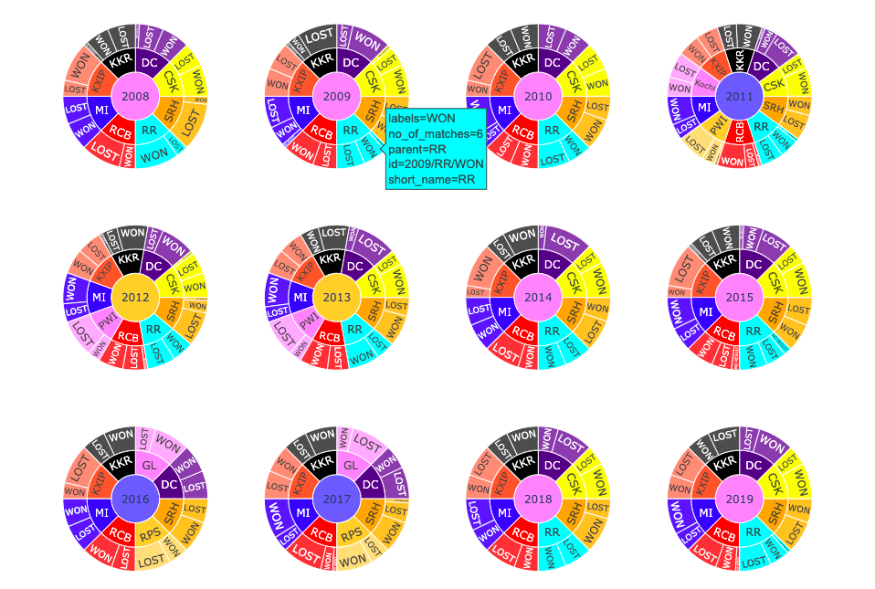
Better Solution
Benefits :
Team positions and their colors are constant across the plots.
Number of wins and Number of losses both included in the plot.

Slide 20
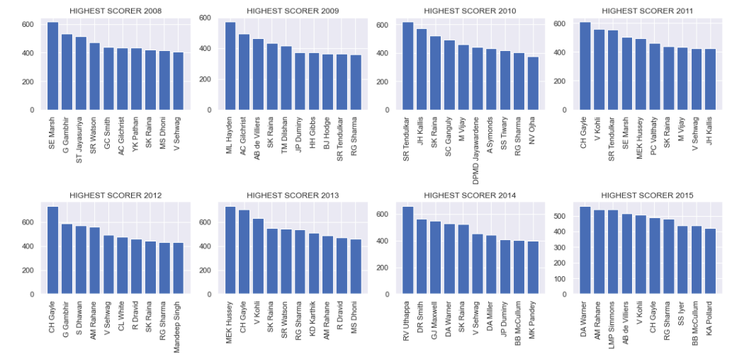
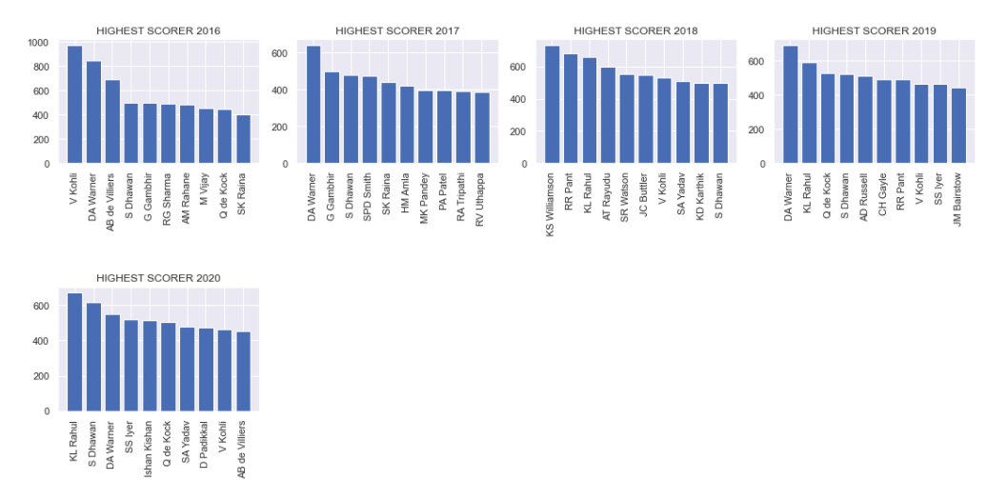
Highest Number of Runs in Each Season
Insights:
In most of the seasons, the top scorer scored in the range of 500 to 700 runs.
V Kohli for the first time, scored almost 1000 runs in a single season of 2016.
SK Raina has been the most consistent batsman getting featured regularly in the top 10 with a count of 9 out of 13 seasons. However, he has never been the top scorer in any season.

Slide 21
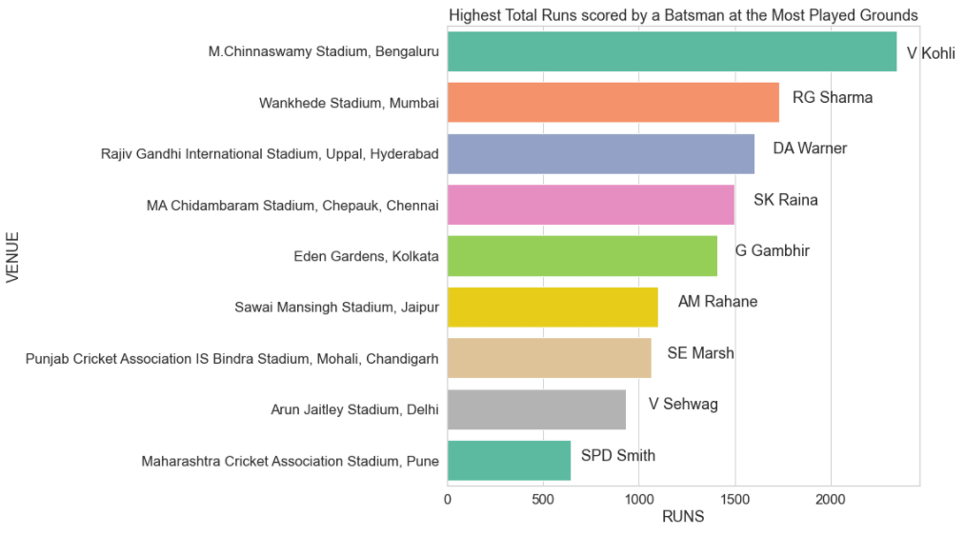
Highest Total Runs Scored by a Batsman at a Particular Venue
Insights:
Players featuring most in their home ground will have an advantage of scoring more runs in that venue.
We see that almost all the players with more runs in a particular venue belong to the home team.

Slide 22
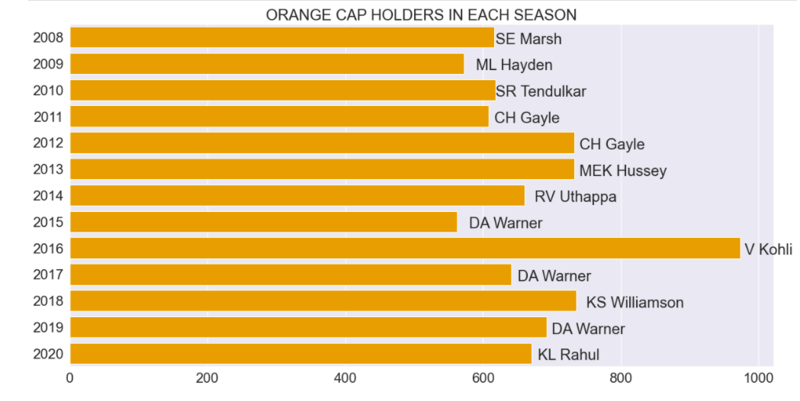
Orange Cap Holders of all Seasons
Batsman scoring the highest number of runs in a season is awarded the title of “Orange Cap”.
Batsmen usually score in the range of 500 to 700.
V Kohli scored the highest runs in a single season.

Slide 23
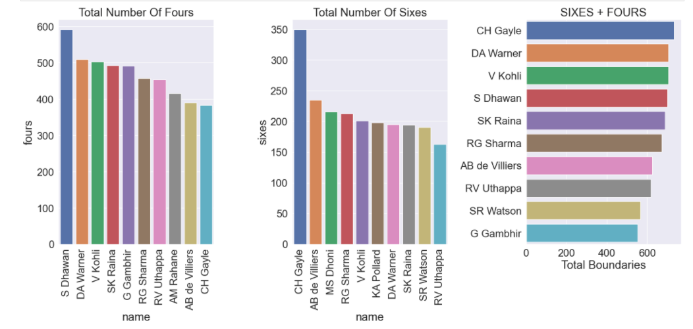
Highest Total Boundaries
S Dhawan scored the highest number of fours.
CH Gayle has scored the highest number of sixes and total boundaries

Slide 24
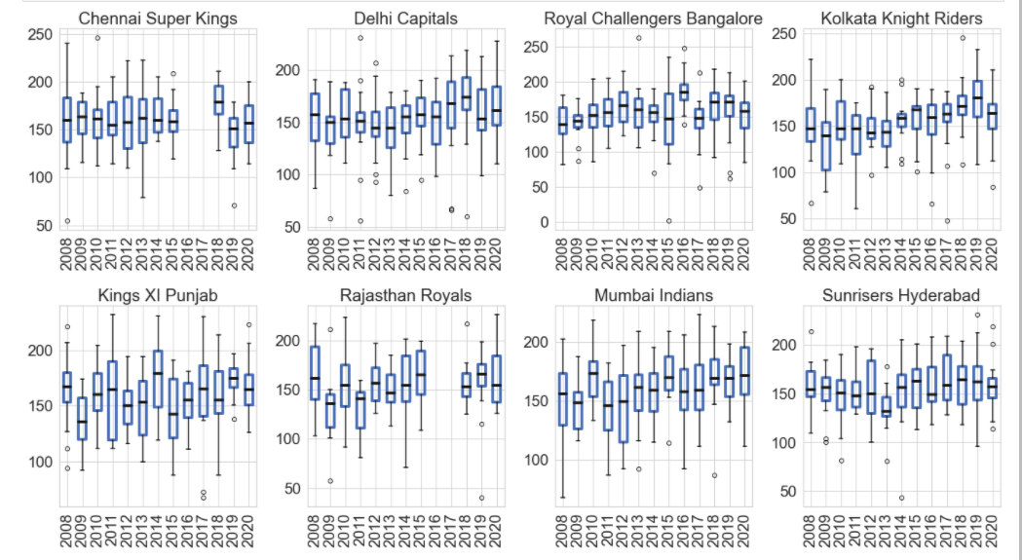
Runs distribution of each team in each season
Royal Challengers Bangalore is the only team to have scored more than 250 runs in a single innings.
All other teams have managed to score more than 200 runs at least once.

Slide 25
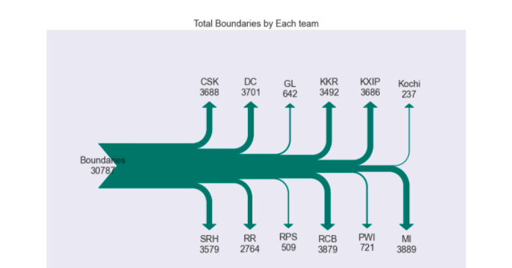
Total Boundaries of each team using Sankey Diagram
The Sankey diagrams visualizes the no of boundaries scored by each team
MI have scored highest no of boundaries among all teams
GL, Kochi, RPS, PWI have scored less boundaries since they have played only limited seasons
Among the regular teams, RR have scores least no of boundaries

Slide 26
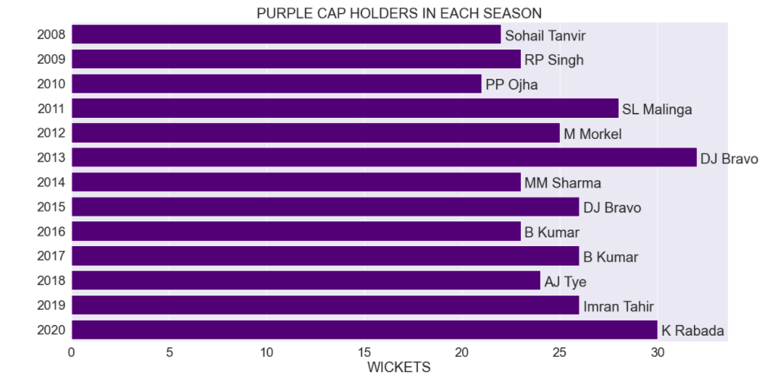
Purple Cap Holders in each season
Bowlers picking the highest wickets in a single season are awarded the “Purple Cap title”.
DJ Bravo picked up the highest number of wickets in a single season.

Slide 27
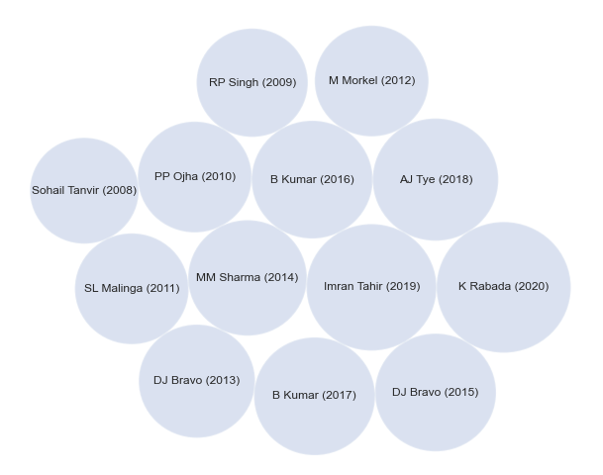
Purple Cap Holders Using Circlify
Drawbacks:
Can’t visualize the area of circle as frequency which proves Steven’s Power Law.

Slide 28
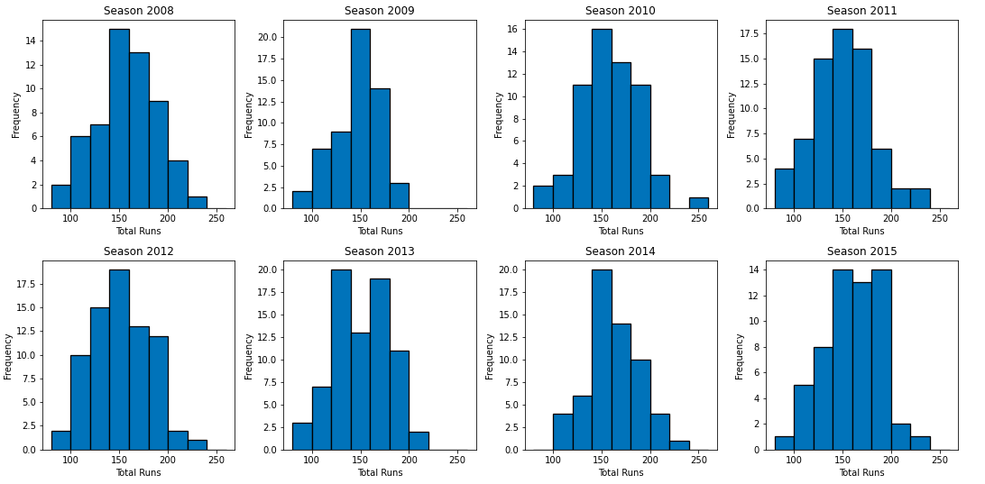
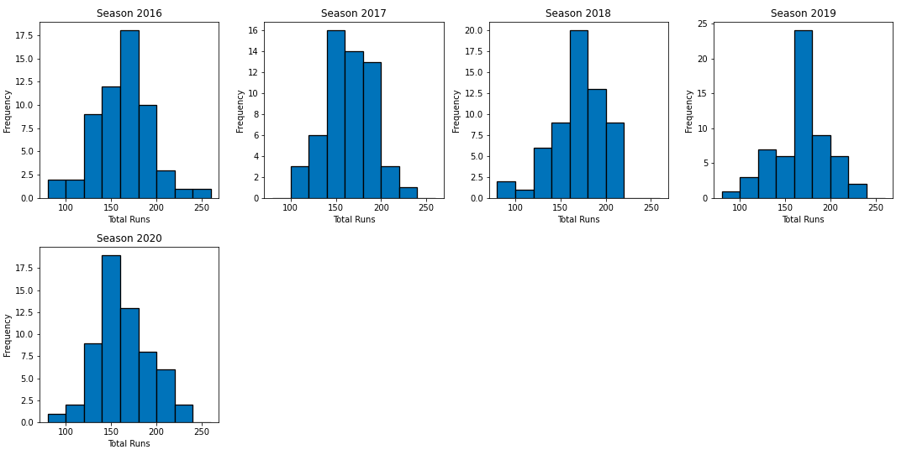
Runs Scored by all teams in all seasons
Insights:
On an average 150-160 bin range has the most frequency in all seasons which means that most teams are scoring in that range.

Slide 29
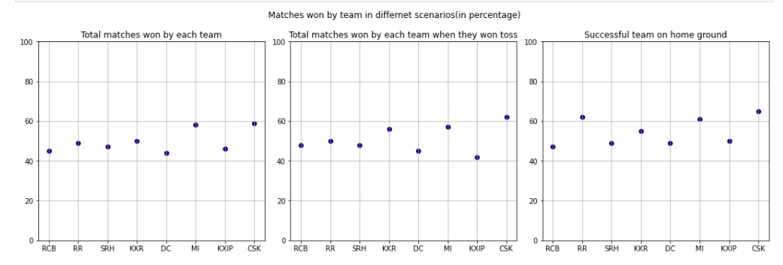
Highest Percentage of wins by a team
Insights:
CSK has the highest successful win rate on their home ground.
CSK and MI are good performing teams on any given scenario.

Slide 30
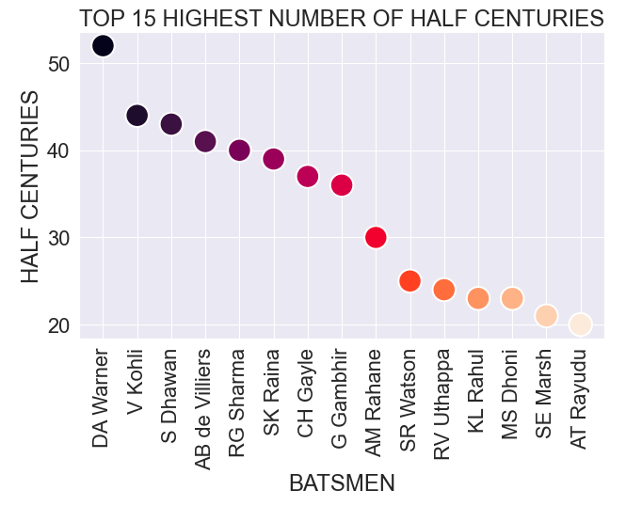
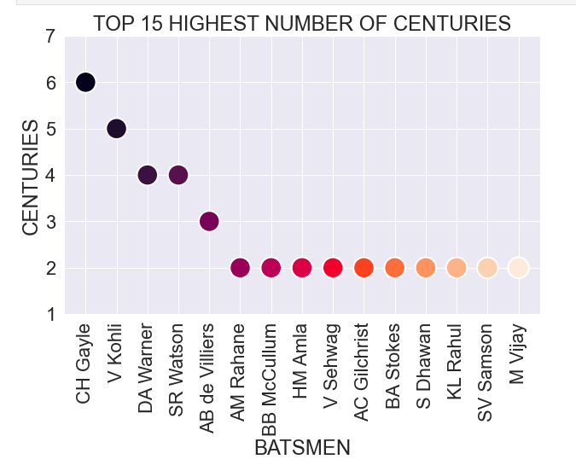
Half centuries and Centuries

Slide 31
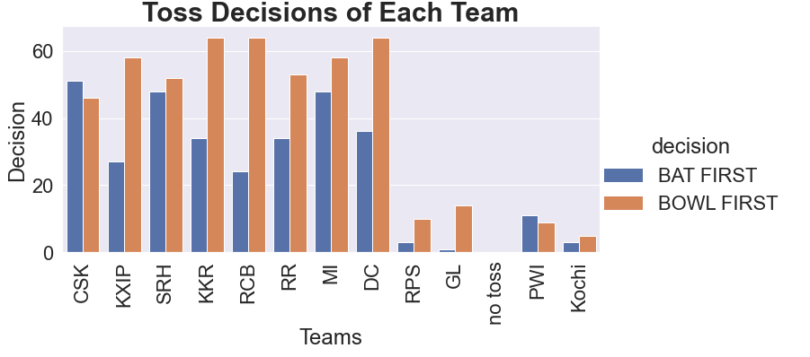
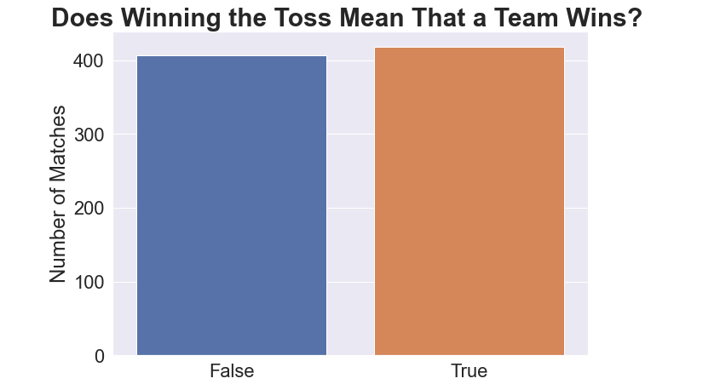
Teams winning Toss

Slide 32
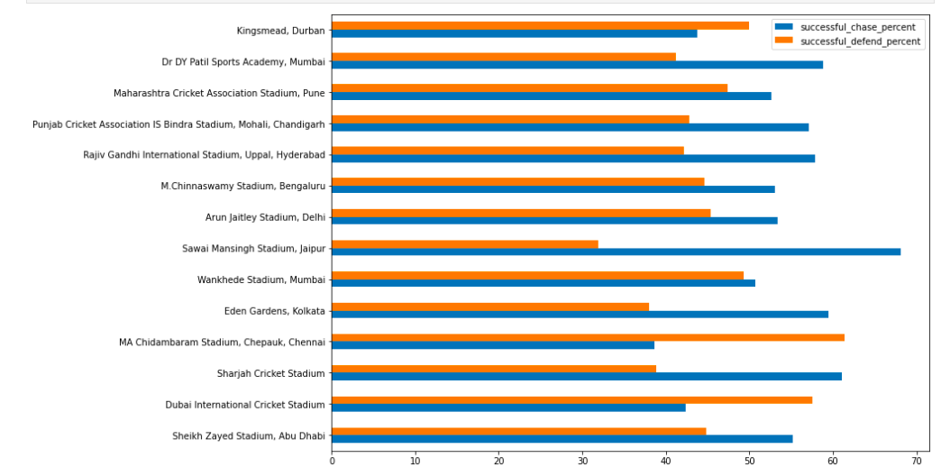
Successful venues for defending and chasing
We can see that most of the venues have the successful chase percent which clearly proves why most of the teams choose to bowl first.
We can also see that there are three venues with most successful defend percent and Chennai is one of them which proves why CSK chooses to bat first when they win the toss.

Slide 33
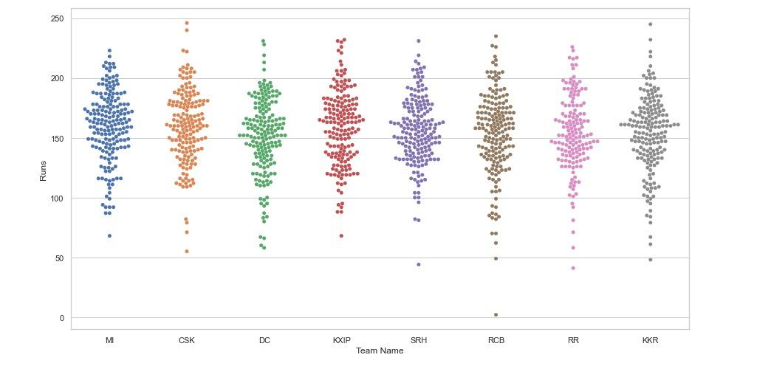
Beeswarm plot for Team and their total runs for all seasons
The Beeswarm plot shows the distribution of runs for each team across all seasons.
We can see that 150-200 runs has the highest frequency range with respect to the total runs of a team

Slide 34
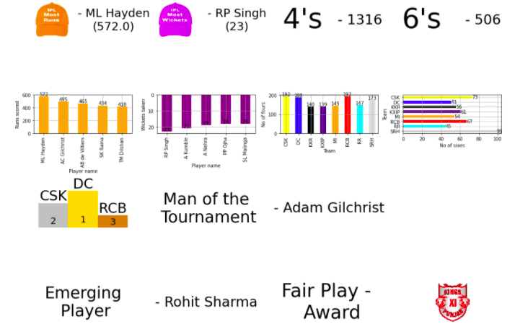
Season Overview

Slide 35
Season Stats

Slide 36
Libraries & Links
Github : https://github.com/umesh-gattem/IPL-D-VIZ
Libraries Used in project :
Pandas
Numpy
Matplotlib
Geopy
Folium
Word Cloud
Plotly
Seaborn
Circlify

Slide 37
References
https://www.kaggle.com/rajsengo/indian-premier-league-ipl-all-seasons?select=all_seaso n_details.csv
https://machinelearningknowledge.ai/ipl-data-analysis-and-visualization-project-using-python/
https://techtrunk.in/ipl-data-analysis/
https://www.kaggle.com/rishpande/indian-premier-league-ipl-data-visualization
https://www.sciencedirect.com/science/article/pii/S1877050917327023

Slide 38
References
https://livecodestream.dev/post/how-to-plot-your-data-on-maps-using-python-and-folium/
https://www.geeksforgeeks.org/how-to-get-geolocation-in-python/
https://colab.research.google.com/drive/1MnZepW9RLJjXKnbgxtIl0zcGAmwO4R9J?usp=sharing#scrollTo=KQcZdM3kQvyY
https://plotly.com/python/sunburst-charts/
https://github.com/holtzy/The-Python-Graph-Gallery/blob/master/src/notebooks/circular-packing-1-level-hierarchy.ipynb

Slide 39
Future Work
The same code can be used for later seasons of the IPL data also since code is written in such a way that we just need to provide new data and it will render the visualizations upto the date.
So we are planning to maintain the project in the following years and work on any new insights or new problem statements and add more visualizations.

Slide 40
Not The End
A Lot More …..

